Slide 1
16bit Bootloader API reference
Steps to follow

Slide 2
Versions Used
MPLABX IDE : v6.20.(Support)
Packs : 1.5.258 (Latest Supported).
Compiler xc16 : v2.10 .
MCC Core : 5.7.1 (Latest Supported).
Bootloader16bit-1.25.0 or latest(Supported).
Java Version : 8.0.4110.9

Slide 3
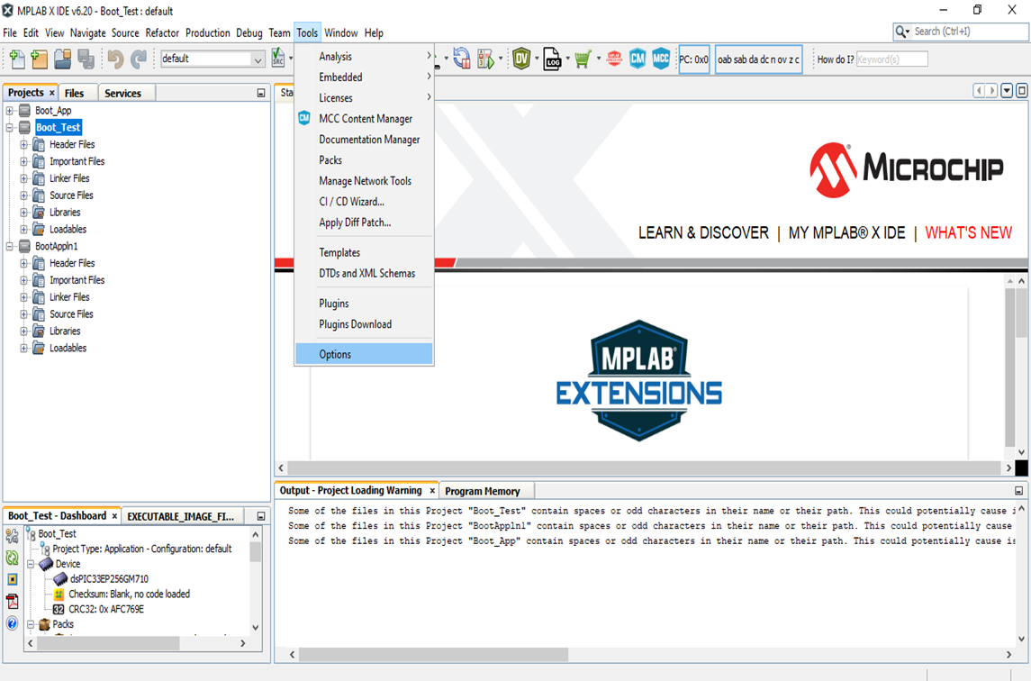
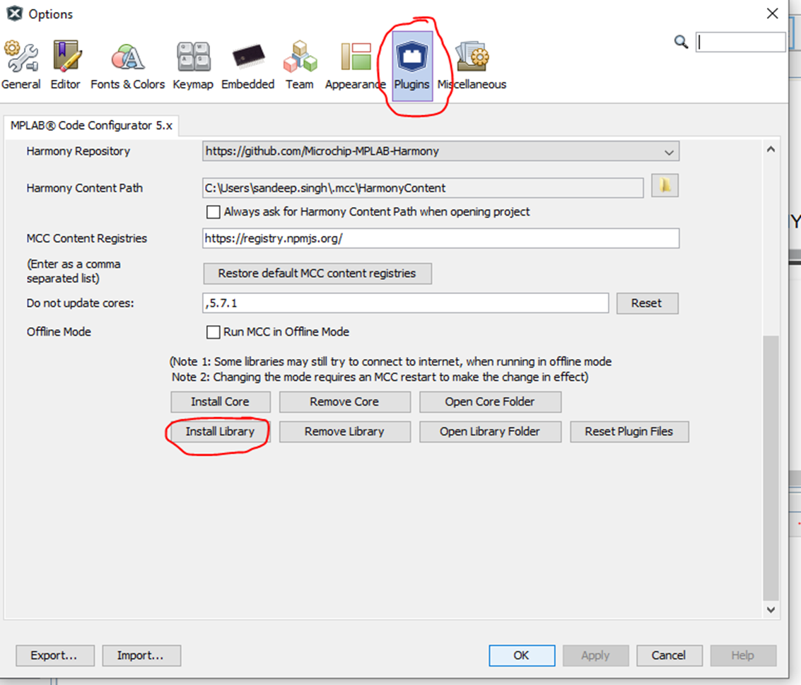
Installing Bootloader Library
Tools -> Options->Plugins
Plugins -> install Library

Slide 4
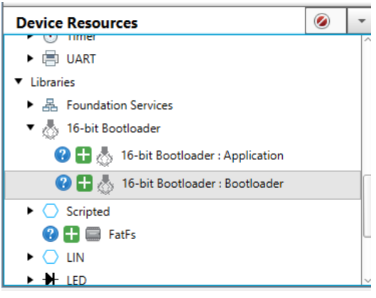
Generate Bootload code in MCC
Generate normal Led Glow/serial Print for Bootload mode indication.
Add 16 bit Bootloader Library in the Bootloader Code

Slide 5
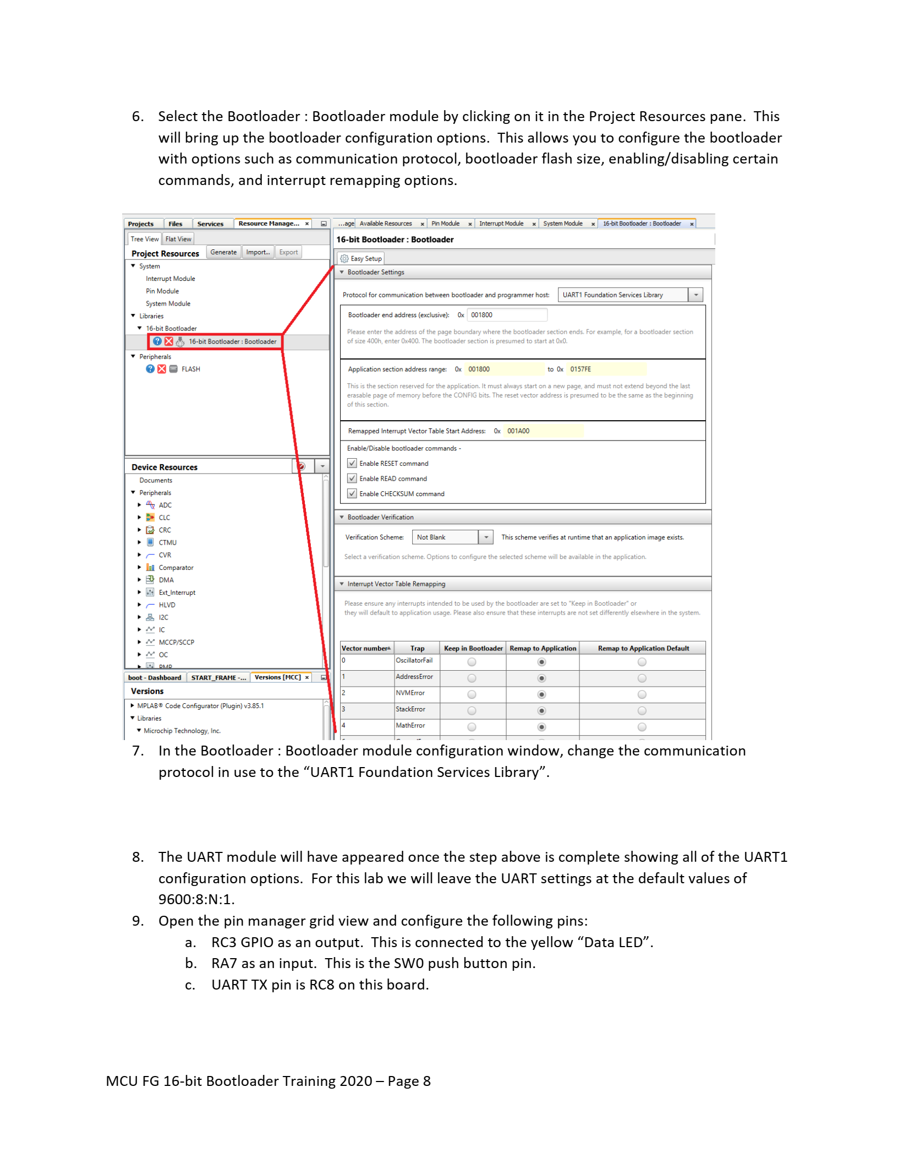
Bootload Setup
Select the Communication protocol and Port to be used between Bootloader and programmer Host (Eg: UART1 Foundation Services Library)
User Defined End Address for BootLoader (Recommended to keep Default)
Enable all Bootloader Commands
Select Bootloader Verification :
Verification Scheme : Not Blank ,Checksum, CRC32,SHA256,ECDSA
(Here we used Not Blank)

Slide 6
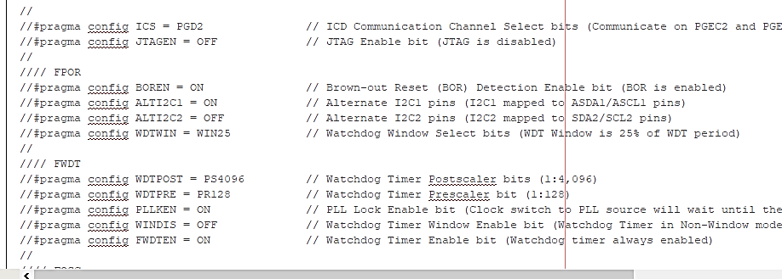
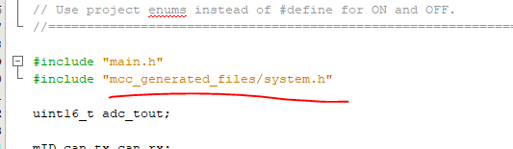
Selecting Required Application Code
Step 3 : Get Application Code
Step 4 : Compile Application Code to get Hex file and Hex code
Step 5 : Add Application Bootloader Library to Application Code
Step 6 : Comment Configuration bits in main file, include “mcc generated files/System.h” instead.

Slide 7
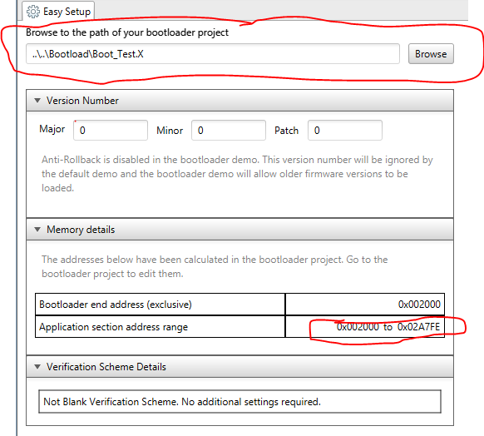
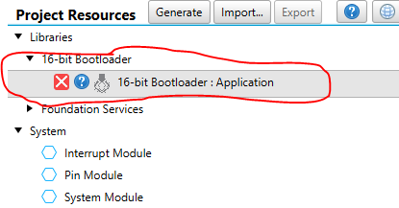
Link Application Code to Bootloader code using MCC to get available program memory range details

Slide 8
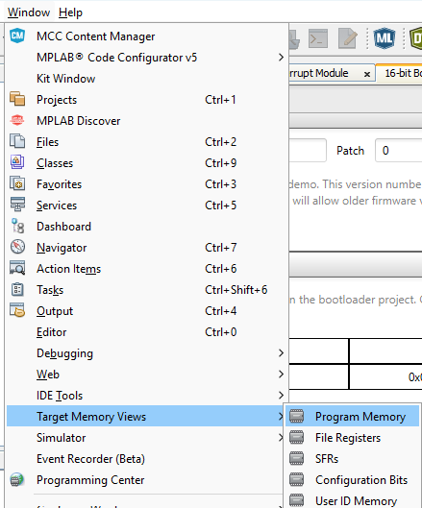
Obtain Hex code of the application Code
To obtain hex code we have to go to Program Memory under Target Memory View

Slide 9
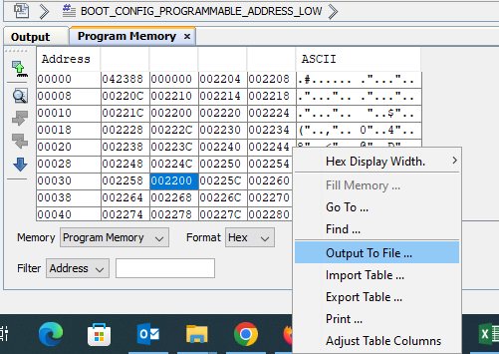
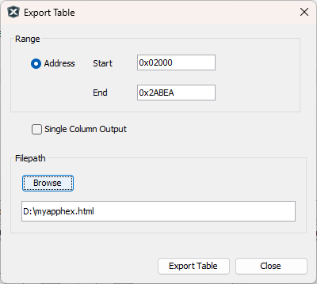
We have to select hex Format before selecting Output to the File or Export Table if we need in single line.
This hex code is to be converted as per UBHA required to send in WRITE_FLASH Command
Data Conversion (Excel Sheet)

Slide 10
Create Packets as per the Commands in sequence Listed below
List of commands in sequence as UBHA
GET_MEMORY_ADDRESS_RANGE = 0x0B
READ_VERSION = 0x00
ERASE_FLASH = 0x03
WRITE_FLASH = 0x02
READ_FLASH = 0x01
RESET_DEVICE = 0x09
Optional Command
CALC_CHECKSUM = 0x08(not recommended)
SELF_VERIFY = 0x0A
Note : Details on commands and responses are listed in Excel sheet.

